Slide 1

Web Application Development
COMP-229

Slide 2
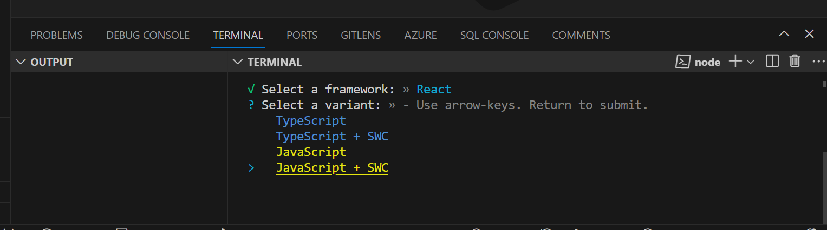
Create a folder and give it a name e.g portfolio
Open the folder in vscode
At the terminal create a react app using vite with the following command:
npm create vite
OR
npm init vite
Change the project name to client
Select React
Select JavaScript+SWC

Slide 3
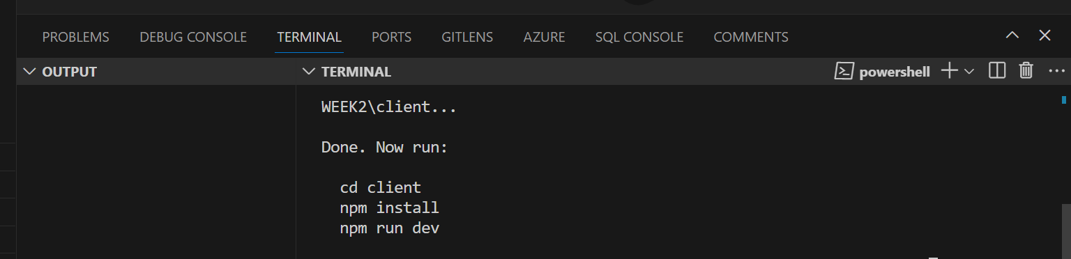
cd client
npm install
npm run dev

Slide 4
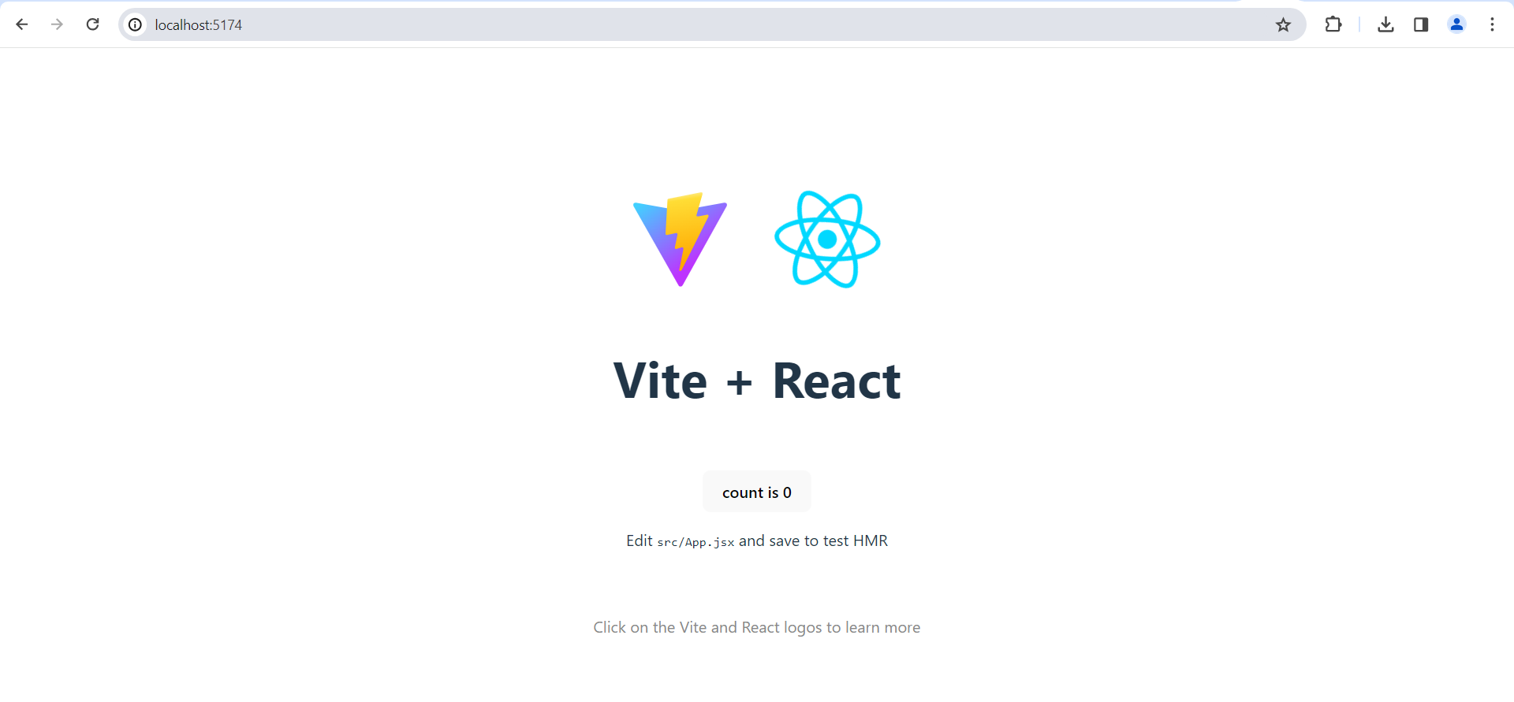

Slide 5
using JavaScript with SWC allows you to write modern JavaScript code, including JSX if needed, and efficiently compile it for use in web applications.

Slide 6
In the client folder, create another folder called components
In the components folder create a file called Home.jsx
export default function Home() {
return <p>Hello World!</p>
}

Slide 7
In the client folder create a file called MainRouter.jsx
Add the following code:
import React from 'react'
import { Route, Routes } from 'react-router-dom'
import Home from './components/Home'
const MainRouter = () => {
return (<div>
<Routes>
<Route exact path="/" element={<Home />} />
</Routes>
</div>
)
}
export default MainRouter

Slide 8
we only have one route "/". If we add another file, ie: "about.jsx" in the "pages or src" folder:
we will be adding another route at "/about" giving us:
Route: "/" - Renders component from “components/Home.jsx"
Route "/about" - Renders component from “src/about.jsx"

Slide 10
In the src folder create a file called about.jsx
Add the following code:
export default function About() {
return (
<>
<p>About</p>
</>
);
}

Slide 13
Updated MainRouter.jsx
Update the MainRouter.jsx with the following code:
import React from 'react'
import { Route, Routes } from 'react-router-dom'
import Home from './components/Home'
import About from './about'
const MainRouter = () => {
return (<div>
<Routes>
<Route exact path="/" element={<Home />} />
<Route exact path="/about" element={<About />} />
</Routes>
</div>
)
}
export default MainRouter

Slide 14
In the src folder create another file/component called contact.jsx
Add the following code to the contact.jsx
export default function Contact() {
return (
<>
<p>Contact</p>
</>
);
}

Slide 15
Updated MainRouter.jsx
Update the MainRouter.jsx as follows:
import React from 'react'
import { Route, Routes } from 'react-router-dom'
import Home from './components/Home'
import About from './about'
import Contact from './contact'
const MainRouter = () => {
return (<div>
<Routes>
<Route exact path="/" element={<Home />} />
<Route exact path="/about" element={<About />} />
<Route exact path="/contact" element={<Contact />} />
</Routes>
</div>
)
}
export default MainRouter

Slide 16
Cd client – make sure you change directory to the client
Install the following:
npm install react-router-dom
npm install link-react –save
OR
npm install link-react
Run the application using the following command:
npm run dev

Slide 17
Education.jsx
Create another component/file in the src folder called education.jsx and project.jsx
Add the following code to the education.jsx file :
export default function Education() {
return (
<>
<p>Education.Qualification</p>
</>
);
}

Slide 18
Project.jsx
Add the following code to project.jsx file:
export default function Project() {
return (
<>
<p>My Projects</p>
</>
);
}

Slide 19
Layout.jsx
In the components folder in the client folder create a file named Layout.jsx.
Add the following code to it:

Slide 20
Updated Layout.jsx
import React from 'react';
import { Link } from 'react-router-dom';
export default function Layout() {
return (
<>
<h1>My Portfolio</h1>
<nav>
<Link to="/">Home</Link> | <Link to="/about">About</Link> | <Link to="/education">Education</Link>| <Link to="/project">Project</Link>| <Link to="/contact">Contact</Link>
</nav>
<hr />
</>
);
}

Slide 21
App.jsx
Replace the App.jsx with the following code:
import React from 'react';
import { BrowserRouter as Router } from 'react-router-dom';
//import { ThemeProvider } from '@material-ui/styles';
import MainRouter from '../MainRouter';
//import Contact from './contact'
//import theme from '../theme';
//import { hot } from 'react-hot-loader'
const App = () => {
return (
<Router>
<MainRouter />
</Router>
);
};
export default App;

Slide 22
Updated MainRouter.jsx
import React from 'react'
import { Route, Routes } from 'react-router-dom'
import Home from './components/Home'
import About from './src/about'
import Contact from './src/contact'
import Education from './src/education'
import Project from './src/project'
import Layout from ‘./components/Layout’
const MainRouter = () => {
return (<div>
<Layout/>
<Routes>
<Route exact path="/" element={<Home />} />
<Route exact path="/about" element={<About />} />
<Route exact path="/education" element={<Education />} />
<Route exact path="/project" element={<Project />} />
<Route exact path="/contact" element={<Contact />} />
</Routes>
</div>
)
}
export default MainRouter

Slide 23
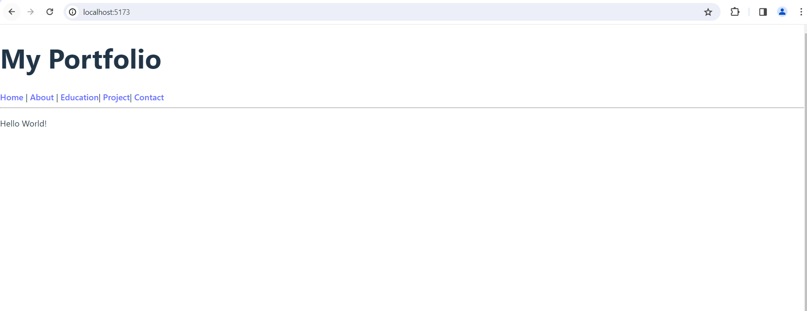

Slide 24
Updated index.css
:root {
font-family: Inter, system-ui, Avenir, Helvetica, Arial, sans-serif;
line-height: 1.5;
font-weight: 400;
color-scheme: light dark;
color: rgba(255, 255, 255, 0.87);
background-color: #242424;
font-synthesis: none;
text-rendering: optimizeLegibility;
-webkit-font-smoothing: antialiased;
-moz-osx-font-smoothing: grayscale;
}
a {
font-weight: 500;
color: #646cff;
text-decoration: inherit;
}
a:hover {
color: #535bf2;
}
body {
margin: 0;
place-items: center;
min-width: 320px;
min-height: 100vh;
}
h1 {
font-size: 3.2em;
line-height: 1.1;
}
button {
border-radius: 8px;
border: 1px solid transparent;
padding: 0.6em 1.2em;
font-size: 1em;
font-weight: 500;
font-family: inherit;
background-color: #1a1a1a;
cursor: pointer;
transition: border-color 0.25s;
}
button:hover {
border-color: #646cff;
}
button:focus,
button:focus-visible {
outline: 4px auto -webkit-focus-ring-color;
}
@media (prefers-color-scheme: light) {
:root {
color: #213547;
background-color: #ffffff;
}
a:hover {
color: #747bff;
}
button {
background-color: #f9f9f9;
}
}
nav {
float:right;
font-size:x-large;
}

Slide 25
Updated Layout.jsx
import React from 'react';
import { Link } from 'react-router-dom';
export default function Layout() {
return (
<>
<h1>My Portfolio</h1>
<nav>
<Link to="/">Home</Link> | <Link to="/about">About</Link> | <Link to="/education">Education</Link>| <Link to="/project">Project</Link>| <Link to="/contact">Contact</Link>
</nav>
<br/>
<hr />
</>
);
}

Slide 26
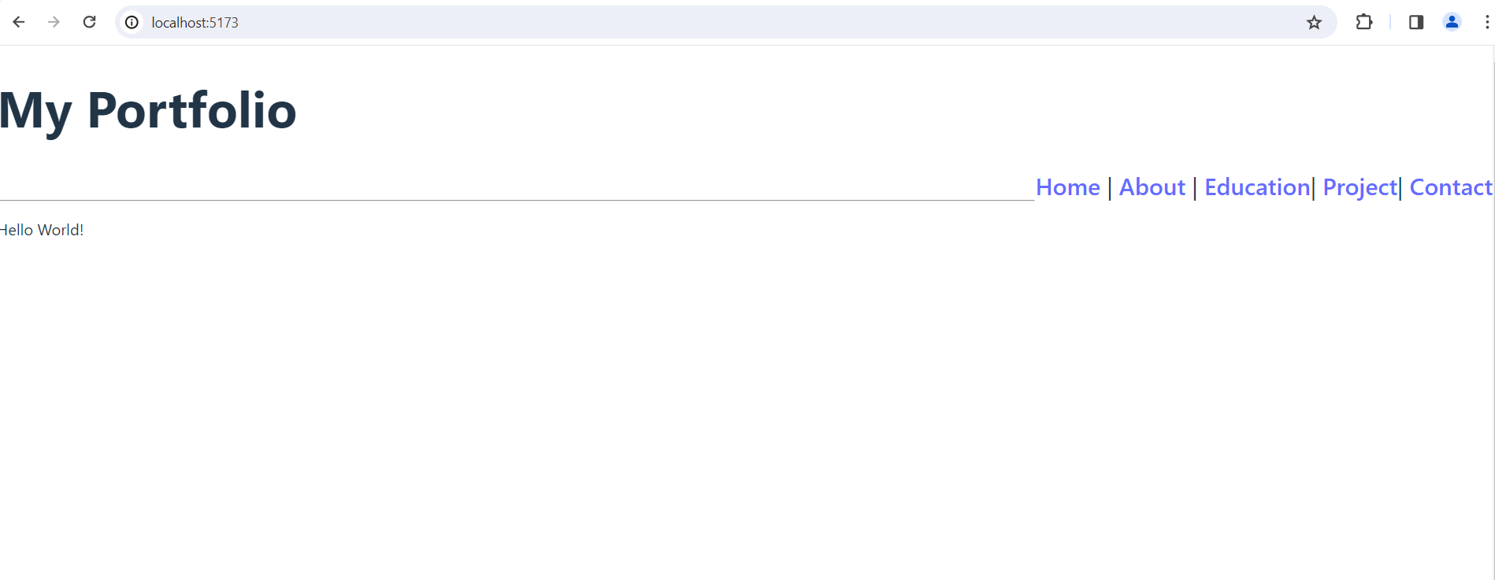

Slide 27
https://www.youtube.com/watch?v=4ag1LsgIUc0

